Slide 1

Budget Tracker

Slide 2
Elevator pitch

Slide 3
Concept
DESCRIPTION
Budget Tracker is an application where users can input their income and expense to track their budget
MOTIVATION FOR DEVELOPMENT
This application has been developed to help anyone who has trouble in keeping their finances afloat as it allows them to organize and monitor their income and expenses to let them know if they are overspending or not
USER STORY
AS A user,
I WANT to list my income and expenses
SO THAT I can track my budget

Slide 4
Process
TECHNOLOGIES USED
HTML
CSS
JS
APIs
AdviceSlip
NBP Web API
BREAKDOWN OF TASKS AND ROLES
Vimo: UI design and CSS work
Cezar: Input section
Ravneet: Table section
Elaine: Forex section
Together: DayJS and AdviceSlip

Slide 5
Process
CHALLENGES
Searching for free forex API
Searching for new CSS library aside from Bootstrap (rework required)
SUCCESSES
Completed project proposal
Completed Input and Forex section
Completed Income and Expense Table + Total Balance section
Completed UI design updates

Slide 6
Demo

Slide 7
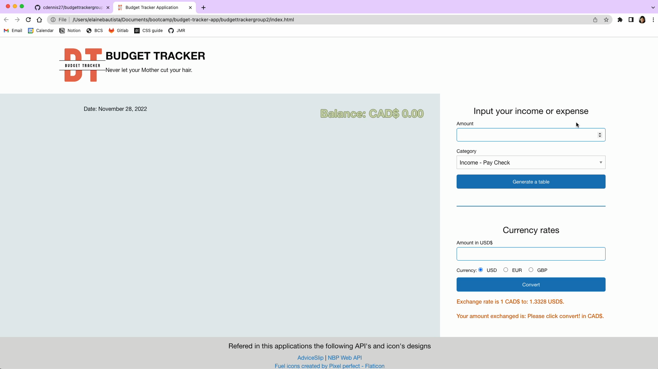

Slide 8
Directions for Future Development
Leverage on ChartJS to visualize income and expenses

Slide 9
Links
DEPLOYED
https://cdennis27.github.io/budgettrackergroup2/
GITHUB REPO
https://github.com/cdennis27/budgettrackergroup2

